Slide 1
Parenthetical documentation
Used to document any external sources used within a document. They direct the reader to the full bibliographic citation used in the works cited page, located at the end of the document.
In most cases parenthetical documentation consists of the author’s name and the specific page number for the information cited.

Slide 2
rules
The author’s last name and page number are placed in parenthesis in the text to give credit to the sources.
If there is no page number, just write the author’s name in the parenthesis.
If there is no author and no page number, write the title of the article in the parenthesis.

Slide 3
Examples:
If the drinking age was lowered from the age of twenty-one, youth drinking would increase (“Drinking Age” 2)
According to the article “Drinking Age,” car crashes are the leading cause of death….(2).
…unintended pregnancy, crime, overdose and other substance use (Wechler and Nelson 2).

Slide 4
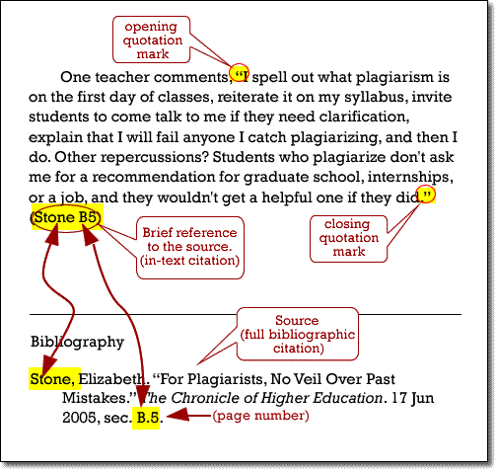
Parenthetical documentation

Slide 5
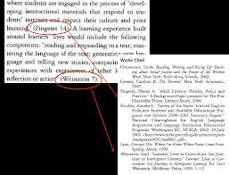

Slide 6
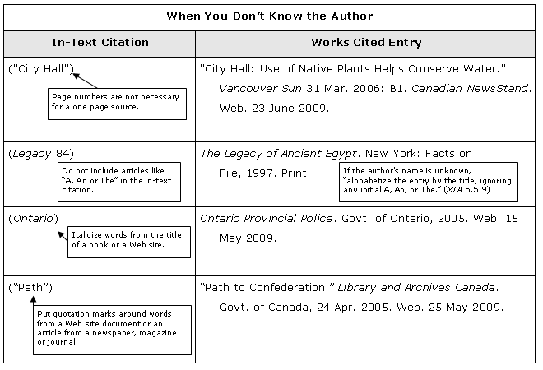

Slide 7
Type/MLA Format
Student 1
Jane Student
Mr. Teacher
English 9
19 April 2002
Title of My Paper Belongs Here
When producing an MLA style essay or paper, format and style are
critical. Margins should be no more than one inch on all sides. There
are three acceptable fonts: Times New Roman, Courier New,
and Arial. The only acceptable font size is 12. The entire essay must be
double-spaced; there is never a time when extra spacing or single
spacing is needed.
There is no title page for an MLA paper. A very specific heading is
Running head
½” from top
4 line heading:
Name/Teacher/
Class/Due Date/
double spaced/
1” margin
Title: centered
Indent
5 spaces
Body:
12 point font
double spaced
Indent
5 spaces
one inch
margins

Slide 8
Works Cited
Austen, Jane. The Complete Novels.
Oxford, New York: Oxford University
Press, 1994.
“Elizabeth I.” 2 Feb. 2002.
<http://www.springfield.k12.edu>.
Jones, John. “Readers Read Reeds.”
New York Times. 26 May 2002: A 9.
“Queen Elizabeth I.” 5 Jan. 2002.
<http://www.geocities.com/eliz/royal/>.
Thornton, William.Elizabethan Literature.
New York, NY: Simon & Schuster, Inc.,2001.
alphabetized
double
spaced
12 point font
1 inch margins
reverse
indent
Back to
Notes

